Slide 1

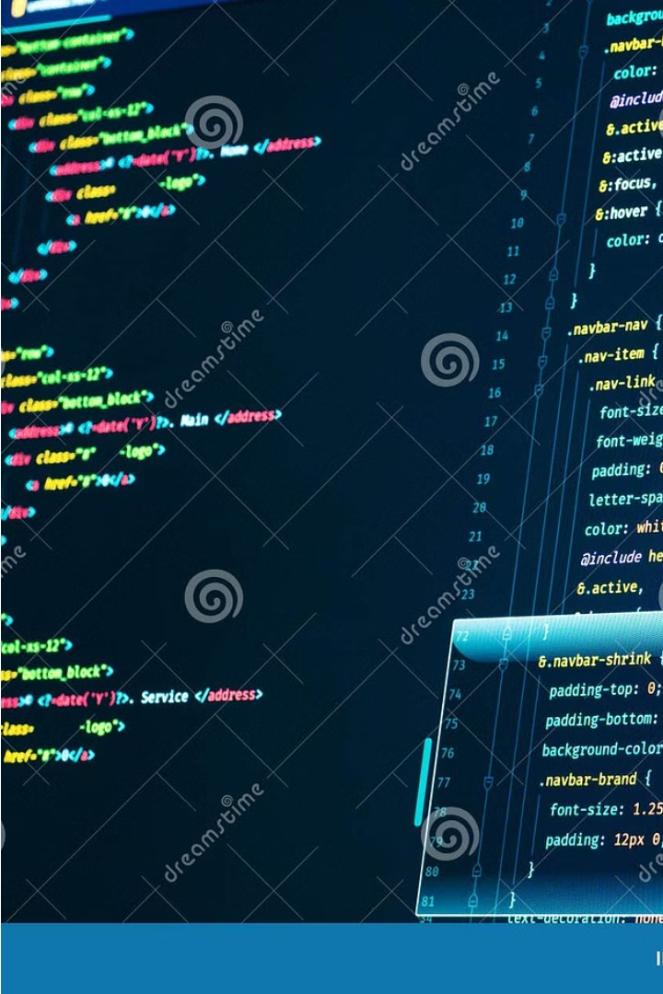

Introduction to HTML
HTML, or Hypertext Markup Language, is the standard language used to create and structure web pages. It provides a way to define the content, layout, and interactivity of a website.
by Pawan Maurya

Slide 2

What is HTML?
HTML is a markup language that uses tags to define the structure and semantics of web page elements, such as headings, paragraphs, links, images, and more. It provides the backbone for building and organizing the content of a website.
1
Markup Language
2
Content Structuring
3
Web Page Foundation
HTML uses a system of tags to describe the structure and layout of a web page.
HTML tags help define the different parts of a web page, like headings, paragraphs, lists, and links.
HTML is the foundational language for creating and displaying web content on the internet.

Slide 3
HTML Structure
Every HTML document has a specific structure that includes a head and a body. The head contains metadata about the page, while the body contains the visible content that is displayed in the web browser.
HTML Structure
Head Section
Body Section
The basic HTML structure includes the <html>, <head>, and <body> tags.
The <head> section contains metadata, like the page title, styles, and scripts.
The <body> section contains the visible content of the web page.

Slide 4




HTML Elements
HTML elements are the building blocks of web pages. They are defined using tags, which are surrounded by angle brackets <>. Elements can have attributes that provide additional information about the element.
Headings
Paragraphs
Links
Images
Headings, defined by <h1> to <h6> tags, structure the content.
Paragraphs, defined by the <p> tag, contain the main text content.
Links, defined by the <a> tag, allow users to navigate between web pages.
Images, defined by the <img> tag, enhance the visual appeal of web pages.

Slide 5
HTML Attributes
HTML attributes provide additional information about an element. They are included inside the opening tag of an element and consist of a name-value pair separated by an equals sign.
Src Attribute
Href Attribute
The src attribute specifies the source of an image or other media.
The href attribute specifies the URL of a hyperlink.
Alt Attribute
Class Attribute
The alt attribute provides alternative text for an image.
The class attribute assigns a name to an element for styling purposes.

Slide 6



HTML Tags
HTML tags are the building blocks that define the structure and meaning of the content on a web page. They are enclosed in angle brackets <> and come in opening and closing pairs.
Structural Tags
Content Tags
Formatting Tags
Tags like <html>, <head>, and <body> define the overall structure of the page.
Tags like <h1>, <p>, and <img> define the different types of content on the page.
Tags like <b>, <i>, and <em> apply formatting to the content.

Slide 7

HTML Formatting
HTML provides a variety of tags for formatting text and other content on web pages. These tags can be used to emphasize, highlight, or structure the information in a visually appealing way.
1
Headings
Headings, from <h1> to <h6>, help organize and structure the content.
2
Text Formatting
Tags like <b>, <i>, and <em> can be used to bold, italicize, or emphasize text.
3
Lists
Ordered (<ol>) and unordered (<ul>) lists help present information in a structured way.

Slide 8
HTML Best Practices
To create effective and well-structured web pages, it's important to follow best practices when using HTML. This ensures the content is accessible, maintainable, and optimized for search engines and user experience.
Use Semantic Tags
Choose tags that accurately reflect the meaning and structure of the content.
Maintain Accessibility
Ensure your pages are accessible to users with disabilities.
Optimize for Search
Use relevant keywords and structure your content for better SEO.
Keep it Clean
Write clean, well-formatted code that is easy to read and maintain.

